Slide 1
CODE Workshop
Introduction to C
Thought by Rahul Bharadwaj

Slide 2
Why are we using C?
How can we read and write code that includes
variables, conditionals, and loops?
Why do we care about data types?
What does it mean to compile a C program?

Slide 3
Part 1
Variables and Types Input and Printing

Slide 4


Slide 5
Variables
calls
4

Slide 6
Variables
int calls = 4;
calls
4

Slide 7
Variables
int calls = 4;
calls
name
4

Slide 8
Variables
int calls = 4;
calls
type
4

Slide 9
Variables
int calls = 4;
calls
value
4

Slide 10
Variables
int calls = 4;
calls
4
assignment operator

Slide 11
Variables
int calls = 4;
type name value assignment
operator
calls
4
"Create an integer variable named calls that gets the value 4."

Slide 12
Variables
int x = 50;
x
50

Slide 13
Variables
int x = 50;
x
50
"Create an integer variable named x that gets the value 50."

Slide 14
Think. Pair.
Share.
Why does C care about data types?

Slide 15
01000001

Slide 16
int
65
01000001

Slide 17
char
'A'
01000001

Slide 18
Variables
int calls = 4; calls = 5;
calls
4

Slide 19
Variables
int calls = 4; calls = 5;
calls
5

Slide 20
Variables
int calls = 4; calls = 5;
name value assignment
operator
calls
5
"calls gets 5."

Slide 21
Operators
int calls = 4; calls = calls + 1;
calls
5

Slide 22
Operators
int calls = 4; calls = calls - 1;
calls
3

Slide 23
Operators
int calls = 4; calls = calls * 2;
calls
8

Slide 24
Operators
int calls = 4; calls = calls / 2;
calls
2

Slide 25
Getting input
int calls = get_int("Calls: ");
type name
function call
assignment operator

Slide 26
Functions
int calls = get_int("Calls: ");
function call

Slide 27
Functions
int calls = get_int("Calls: ");
function name

Slide 28
Functions
int calls = get_int("Calls: ");
arguments

Slide 29
Functions
int calls = get_int("Calls: ");
function call

Slide 30
Return values
int calls = 4;
value

Slide 31
Storing return values
int calls = 4;
type name value assignment
operator
calls
4
"Create an integer variable named calls that gets the value 4."

Slide 32
Printing values
int calls = 4;
printf("calls is %i\n", calls);

Slide 33
Printing values
int calls = 4;
printf("calls is %i\n", calls);
format code

Slide 34
Printing values
int calls = 4;
printf("calls is %i\n", calls);
format code
value

Slide 35
Types and format codes
Numbers Text
int (%i) long (%li) char (%c) float (%f) double (%f) string (%s)

Slide 36
Exercise
Create a C program that prompts a user for:
A name
An age
A phone number
Print the values back to the user as conﬁrmation.

Slide 37
Part 2
Breaking down loops and conditionals

Slide 38
if (calls < 1)
{
printf("Call more often!\n");
}

Slide 39
Boolean expression
if (calls < 1)
{
printf("Call more often!\n");
}

Slide 40
conditional
if (calls < 1)
{
printf("Call more often!");
}

Slide 41
if (calls < 1)
{
printf("Call more often!");
}
executed conditionally

Slide 42
if (calls < 1)
{
printf("Call more often!\n");
}
else
{
printf("Thanks for calling!\n");
}

Slide 43
if (calls < 1)
{
printf("Call more often!\n");
}
else
{
mutually exclusive
printf("Thanks for calling!\n");
}

Slide 44
int i = 0; while (i < 10)
{
printf("%i\n", i); i = i + 1;
}

Slide 45
initialization
int i = 0; while (i < 10)
{
printf("%i\n", i); i = i + 1;
}

Slide 46
Boolean expression
int i = 0; while (i < 10)
{
printf("%i\n", i); i = i + 1;
}

Slide 47
int i = 0; while (i < 10)
{
printf("%i\n", i); i = i + 1;
}
incrementation

Slide 48
int i = 0; while (i < 10)
{
printf("%i\n", i); i = i + 1;
}

Slide 49
for (int i = 0; i < 10; i++)
{
printf("%i\n", i);
}

Slide 50
initialization
for (int i = 0; i < 10; i++)
{
printf("%i\n", i);
}

Slide 51
Boolean expression
for (int i = 0; i < 10; i++)
{
printf("%i\n", i);
}

Slide 52
incrementation
for (int i = 0; i < 10; i++)
{
printf("%i\n", i);
}

Slide 53
for (int i = 0; i < 10; i++)
{
printf("%i\n", i);
}

Slide 54
int n; do
{
n = get_int("n: ");
}
while (n <= 0);

Slide 55
int n; do
{
n = get_int("n: ");
}
while (n <= 0);

Slide 56
int n; do
{
n = get_int("n: ");
}
while (n <= 0);

Slide 57
Part 3
Lab

Slide 58
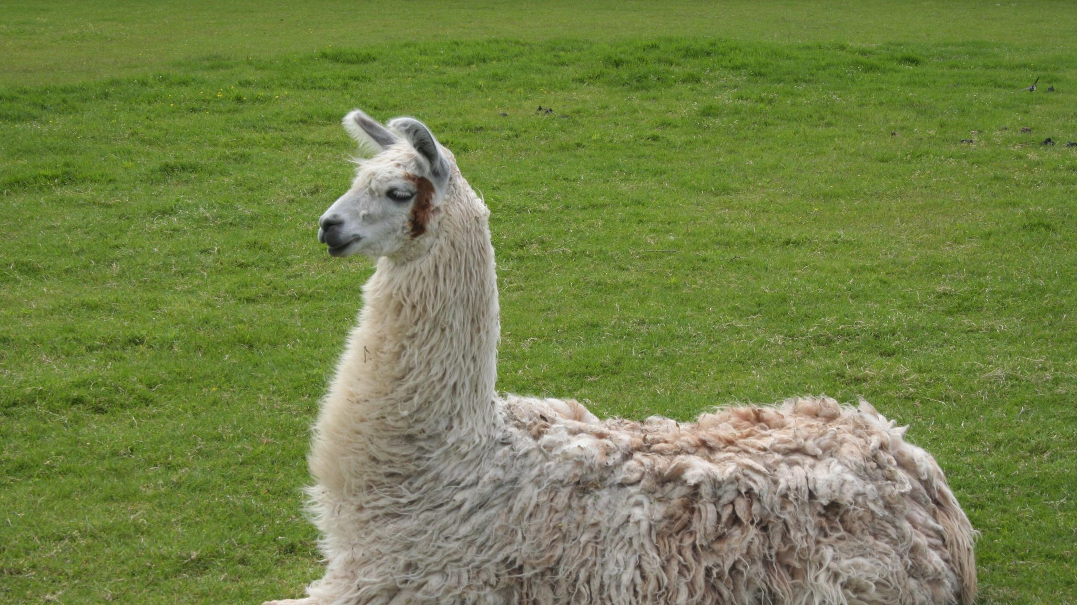

Slide 59
Work an example yourself
Write down exactly what you did
Create an algorithm after working multiple examples
Test your algorithm by hand
Translate your algorithm to code
Find errors in your code by running test cases
Fix errors in your code

Slide 60
Work an example yourself
Write down exactly what you did
Create an algorithm after working multiple examples
Test your algorithm by hand
Translate your algorithm to code
Find errors in your code by running test cases
Fix errors in your code

Slide 61
Work an example yourself
Write down exactly what you did
Create an algorithm after working multiple examples
Test your algorithm by hand
Translate your algorithm to code
Find errors in your code by running test cases
Fix errors in your code

Slide 62
We have a population of n llamas.
Each year, n/3 new llamas are born, and n/4 llamas pass away.
How many years will it take to have a certain population of llamas?

Slide 63
We have a population of 12 llamas.
Each year, 12/3 new llamas are born, and 12/4 llamas pass away.
How many years will it take to have a population of 13 llamas?

Slide 64
Year 0

Slide 65
Year 0

Slide 66
Year 0

Slide 67
Year 0

Slide 68
Year 1

Slide 69
Year 1

Slide 70
Year 1

Slide 71
Year 1

Slide 72
Prompt the user for a starting number of llamas
Prompt the user for a goal number of llamas
Add and subtract llamas every "year" until we reach the goal number of llamas
Print the number of years it took to reach the goal number of llamas

Slide 73
THANK YOU
References: CS50, GeeksforGeeks

